Slide 1
Python Interpreter and program execution

Slide 2
A program is a sequence of instructions that specifies how to perform a Computation. The Computation might be mathematical or working with text.
To write and run Python program, we need to have Python interpreter installed in our computer.

Slide 3
Interpreter
An interpreter is a program that reads and executes code. This includes source code, pre-compiled code, and scripts. Common interpreters include Perl, Python, and Ruby interpreters, which execute Perl, Python, and Ruby code respectively. Interpreters bypass the compilation process and execute the code directly.
The Python interpreter is the application that runs your python script.

Slide 4
The Python interpreter is usually installed as /usr/local/bin/python3.6 on those machines where it is available; putting /usr/local/bin in your Unix shell’s search path makes it possible to start it by typing the command to the shell:
python3.6
On Windows machines, the Python installation is usually placed in C:\Python36, though you can change this when you’re running the installer. To add this directory to your path, you can type the following command into the command prompt in a DOS box.
path=%path%;C:\python36

Slide 5
IDLE (GUI integrated) is the standard, most popular Python development environment. IDLE is an acronym of Integrated Development Environment. It lets edit, run, browse and debug Python Programs from a single interface. This environment makes it easy to write programs.
Python shell can be used in two ways, viz., interactive mode and script mode. Where Interactive Mode, as the name suggests, allows us to interact with OS; script mode let us create and edit python source file. Now, we will first start with interactive mode. Here, we type a Python statement and the interpreter displays the result(s) immediately.

Slide 6
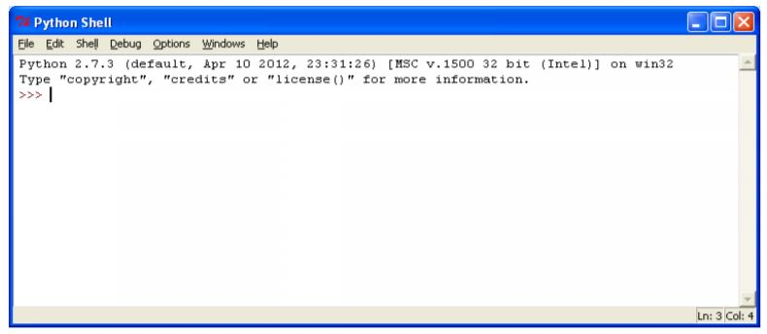
Interactive Mode
For working in the interactive mode, we will start Python.
When we start up the IDLE following window will appear:

Slide 7
What we see is a welcome message of Python interpreter with revision details and the Python prompt, i.e. “>>>”. This is a primary prompt indicating that the interpreter is expecting a python command. There is secondary prompt also which is “…” indicating that interpreter is waiting for additional input to complete the current statement.

Slide 8
Interpreter uses prompt to indicate that it is ready for instruction. Therefore, we can say, if there is prompt on screen, it means IDLE is working in interactive mode.
We type Python expression / statement / command after the prompt and Python immediately responds with the output of it.
Let’s start with typing print command
>>>print(“Welcome to world of python”)
What we get is Python’s response.

Slide 9
Few valid expressions in python:
print (5+7)
5+7
6*250/9
print (8-2)

Slide 10
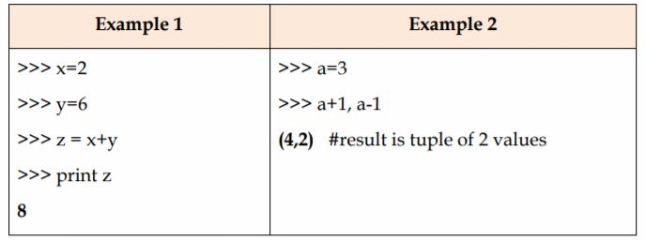
It is also possible to get a sequence of instructions executed through interpreter.
#result is tuple of 2 values, is a comment statement.
Ctrl+D or quit() is used to leave the interpreter. ^F6 will restart the shell.

Slide 11
Script Mode
In script mode, we type Python program in a file and then use the interpreter to execute the content from the file. Working in interactive mode is convenient for beginners and for testing small pieces of code, as we can test them immediately. But for coding more than few lines, we should always save our code so that we may modify and reuse the code.
Note : Result produced by Interpreter in both the modes, viz., Interactive and script mode is exactly same.

Slide 12
Python, in interactive mode, is good enough to learn, experiment or explore, but its only drawback is that we cannot save the statements for further use and we have to retype all the statements to re-run them.
To create and run a Python script, we will use following steps in IDLE, if the script mode is not made available by default with IDLE environment.
File>Open OR File>New Window (for creating a new script file)
Write the Python code as function i.e. script
Save it (^S)
Execute it in interactive mode- by using RUN option (^F5)
Note: For every updation of script file, we need to repeat step 3 & step 4

Slide 13
If we write Example 1 in script mode, it will be written in the following way:
Step 1: File> New Window
Step 2:
x=2
y=6
z = x+y
print (z)

Slide 14
Step 3:
Use File > Save or File > Save As - option for saving the file
(By convention all Python program files have names which end with .py)
Step 4:
For execution, press ^F5, and we will go to Python prompt (in other window)
>>> test()

Slide 15
Python Variables
A variable is a named location used to store data in the memory. It is helpful to think of variables as a container that holds data which can be changed later throughout programming. For example:
number = 10
Here, we have created a named number. We have assigned value 10 to the variable.
You can think variable as a bag to store books in it and those books can be replaced at any time.
number =10
number= 1.1
Note: In Python, we don't assign values to the variables, whereas Python gives the reference of the object (value) to the variable.

Slide 16
Assigning a value to a Variable in Python
As you can see from the above example, you can use the assignment operator = to assign a value to a variable.
Assigning multiple values to multiple variables
a, b, c = 5, 3.2, "Hello“
print (a)
print (b)
print (c)

Slide 17
If we want to assign the same value to multiple variables at once, we can do this as
x = y = z = "same“
print (x)
print (y)
print (z)

Slide 18
Constants
A constant is a type of variable whose value cannot be changed. It is helpful to think of constants as containers that hold information which cannot be changed later.
Non technically, you can think of constant as a bag to store some books and those books cannot be replaced once placed inside the bag.
In Python, constants are usually declared and assigned on a module. Here, the module means a new file containing variables, functions etc which is imported to main file. Inside the module, constants are written in all capital letters and underscores separating the words.

Slide 19
Declaring and assigning value to a constant
Create a constant.py
Create a main.py
PI = 3.14
import constant print(constant.PI)

Slide 20
Rules and Naming Convention for Variables and constants
Constant and variable names should have a combination of letters in lowercase (a to z) or uppercase (A to Z) or digits (0 to 9) or an underscore (_).
Create a name that makes sense. For example, vowel makes more sense than v.
If you want to create a variable name having two words, use underscore to separate them.
Use capital letters possible to declare a constant.
Never use special symbols like !, @, #, $, %, etc.
Don't start a variable name with a digit.

Slide 21
Literals
Literal is a raw data given in a variable or constant. In Python, there are various types of literals they are as follows:
Numeric Literals
Numeric Literals are immutable (unchangeable). Numeric literals can belong to 3 different numerical types Integer, Float, and Complex.
String literals
A string literal is a sequence of characters surrounded by quotes. We can use both single, double or triple quotes for a string. And, a character literal is a single character surrounded by single or double quotes.

Slide 22
Boolean literals
A Boolean literal can have any of the two values: True or False
Special literals
Python contains one special literal i.e. None

